Slide 1
BRAIN pHASER
Presented By: Nick Tope, Katie Bolen, Eric Spahr, Angie Volstad

Slide 2
Overview
Add additional functionality to the pre-existing Brain Phaser Application
Game Modes
Phaser Attack
3 Phaseout
Sudden Phase
Additional Challenge Categories
Additional Challenge Questions
Comparatively similar visual appearance

Slide 3
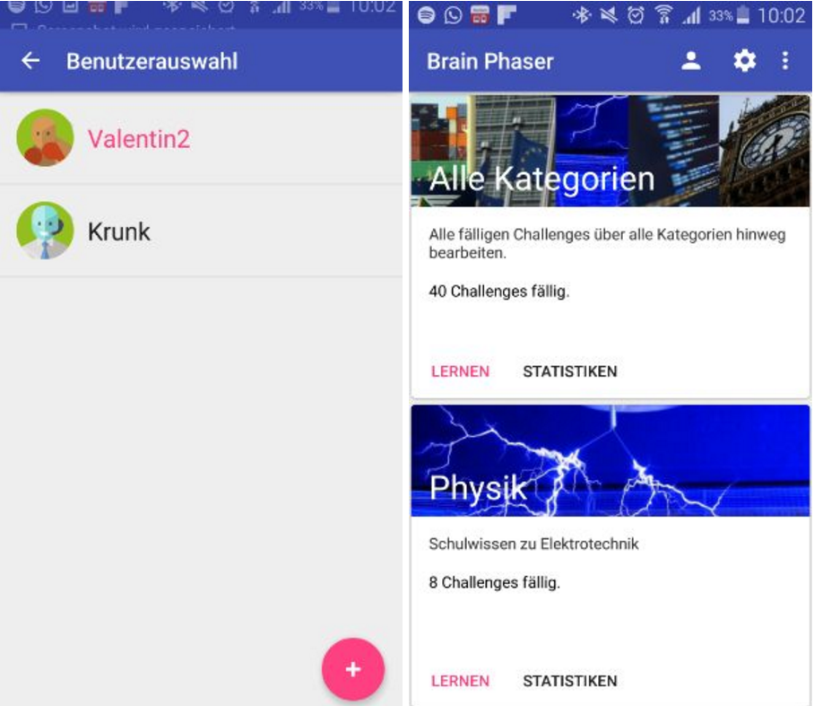
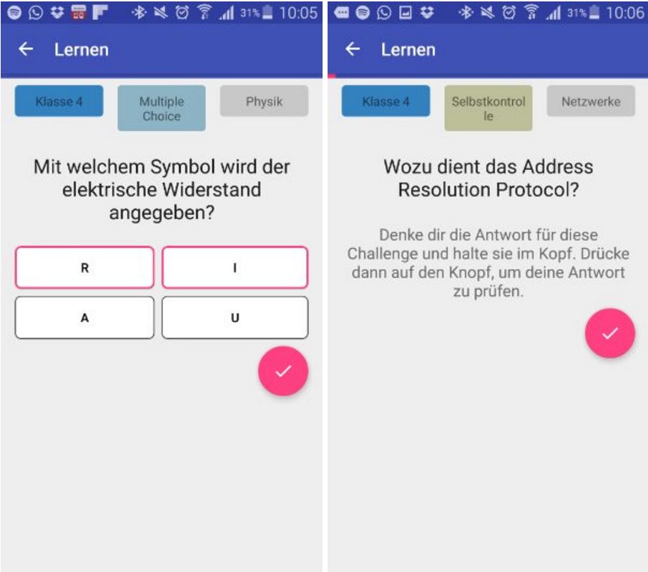
Original State

Slide 4
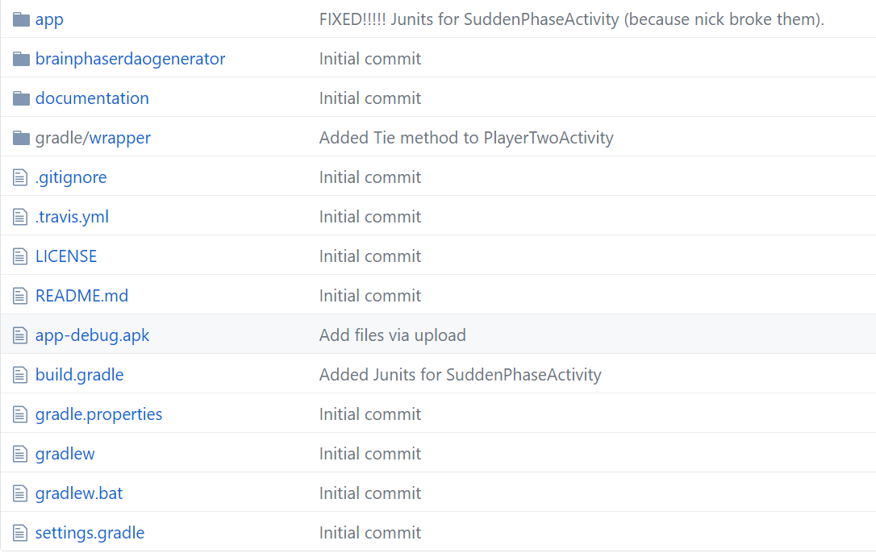
Github
URL → https://github.com/tope018/CSC439_Project
Download the zip file
Install apk on android phone or emulator
OR
Open zip file in Android Studio

Slide 5
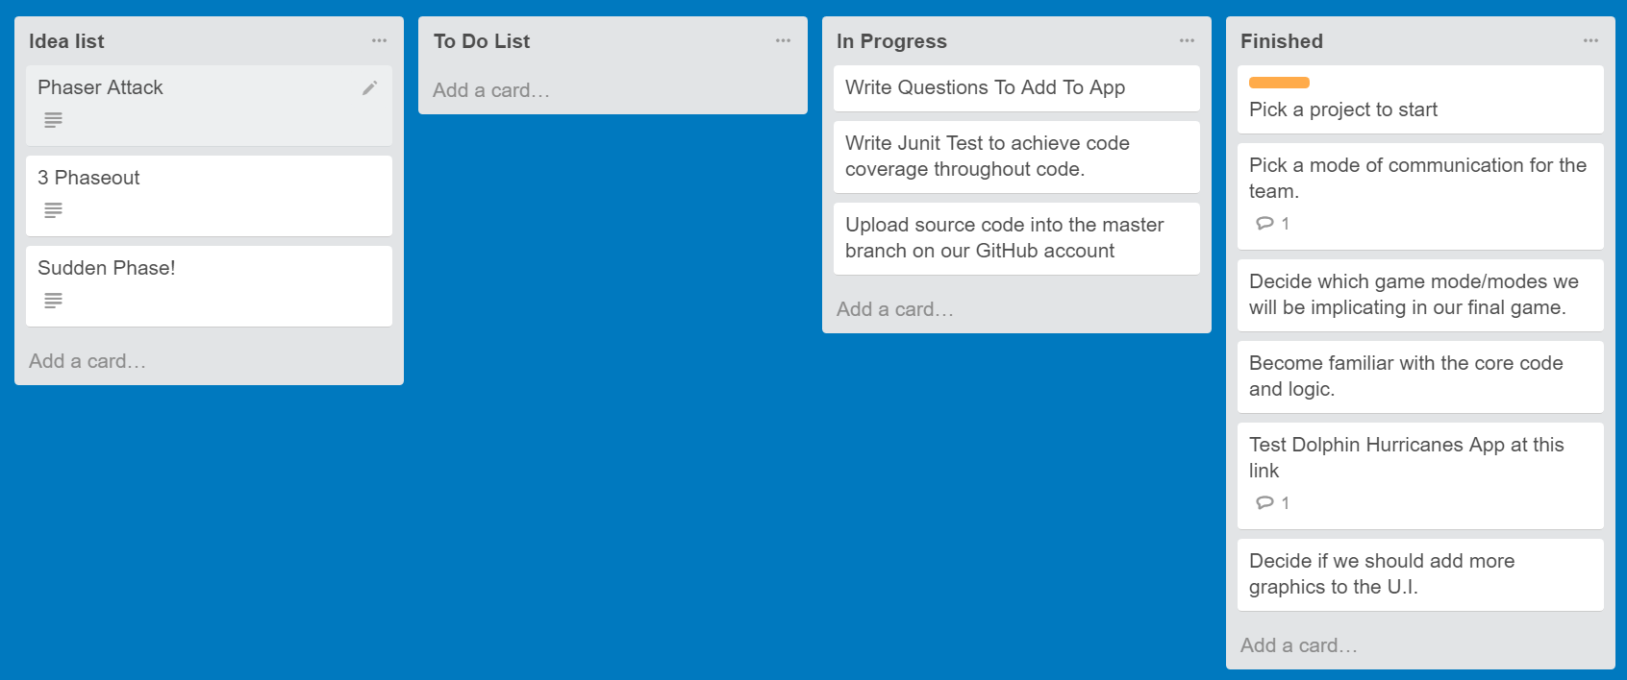
Communication
Trello
https://trello.com/csc439project1
Text
GitHub

Slide 6
Specific Responsibilities
Angie (Record Keeping)
Weekly Minutes, Phase 1 document, Phase 2 document, Phase 3 document, Challenge Questions, Phaser Attack
Eric (Unit Testing)
J-Units, Continuous Integration
Katie (Documentation & Code Development)
Phase Out game mode, Phase 1 document, Phase 2 document, Phase 3 document, Challenge Questions
Nick (Code Development)
Main Menu, Sudden Phase, Phaser Attack

Slide 7
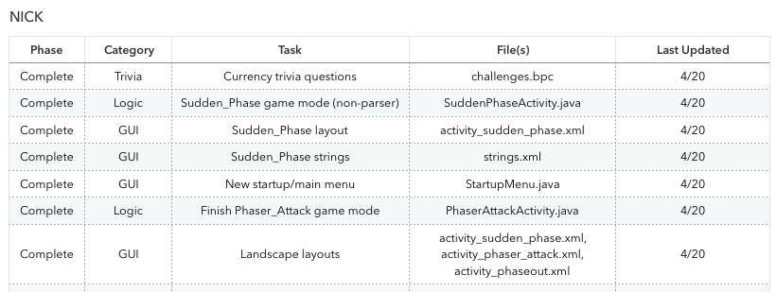
Nick

Slide 8
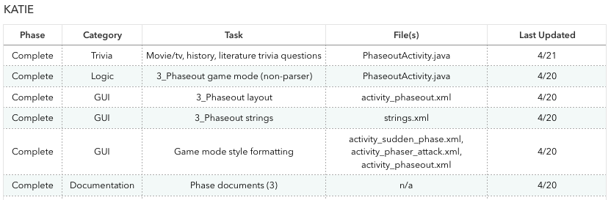
Katie

Slide 9
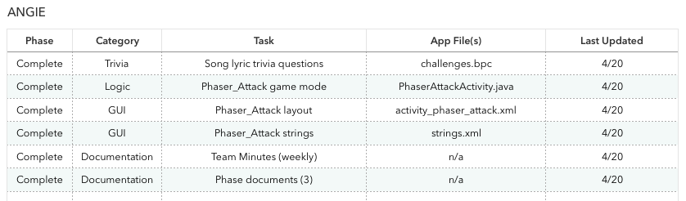
Angie

Slide 10
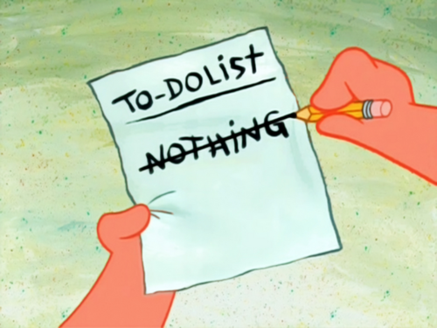
ERic

Slide 11
TimeLine

Slide 12
IDE, Language, Build System
IDE: Android Studio
Language: Java
Build System: Gradle

Slide 13
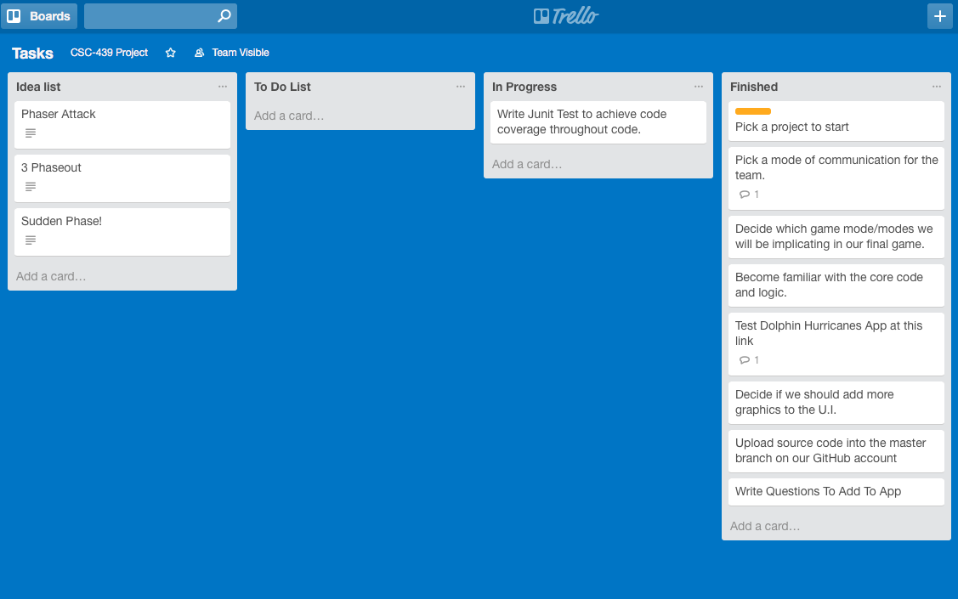
Trello and Backlog management
Project tasks on Trello
Tasks documented in spreadsheet
Status
Category (GUI, Logic, Trivia, Documentation)
Primary responsible team member
Unforeseen new tasks added to Trello
All activity documented in project spreadsheet

Slide 14
Scrum meetings and takeaways

Slide 15
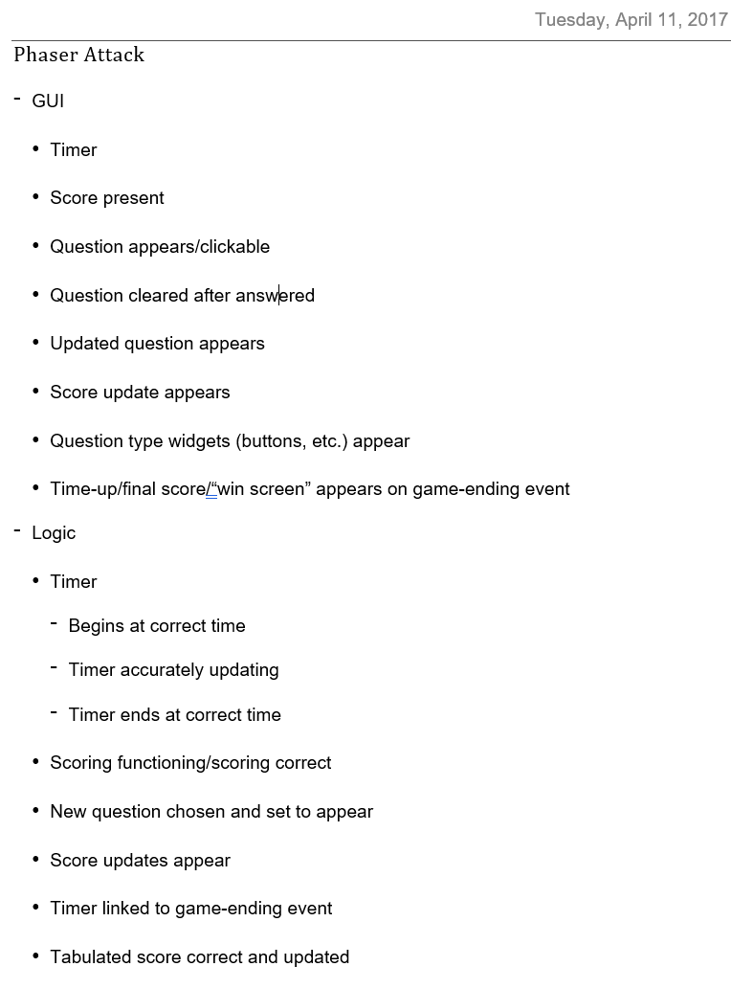
Sprint Planning meeting
Discuss what we can accomplish over the sprint

Slide 16
Daily stand-up
Discuss what was done since the preceding stand-up
Discuss what we’re going to do by the next stand-up
Discuss any roadblocks that have arisen since the last stand-up

Slide 17
Sprint review
Complete phase documentation
Present the added functionality to the team and a possible audience

Slide 18
Sprint retrospective
Discuss incomplete tasks to carry over to the next sprint
How to make the next sprint more effective
E.g. Uploaded GitHub commits at a more frequent rate

Slide 19
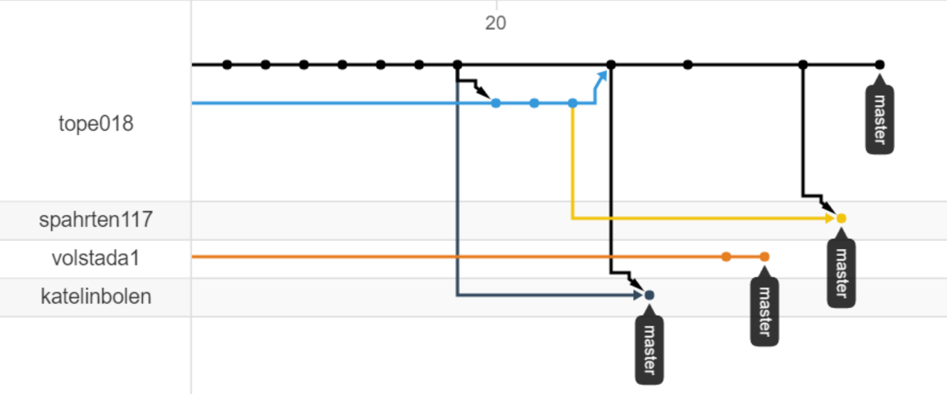
Git and version Management

Slide 20
Continuous integration
Jenkins continuous integration
Plugins: Git, GitHub, Android, JUnit, Gradle

Slide 21
CI reporting
//TODO ERIC

Slide 22
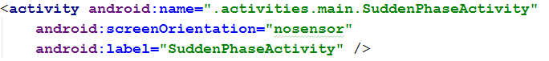
Bugs found and fixed
Only one bug was found
Saved Preferences when screen orientation is changed
Fixed by changing screenOrientation to “nosensor”

Slide 23
Bug fixing methodology
Attempted to update SharedPreference variables in each game mode
After multiple attempts, still failed to pass
What to do?!!

Slide 24


Slide 25
Work around!
If we can’t save values during screen rotations, then there will be no screen rotations

Slide 26
Static analysis
Android Studio FindBugs plug-in
Flagged basic syntax issues:
No default or breaks in switch-statements
Flagged unused variables

Slide 27
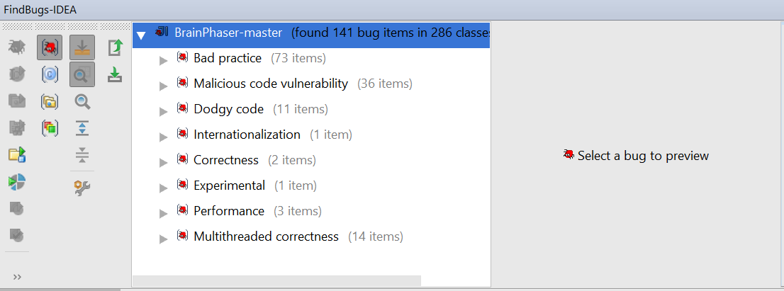
Static analysis issues found & fixed

Slide 28
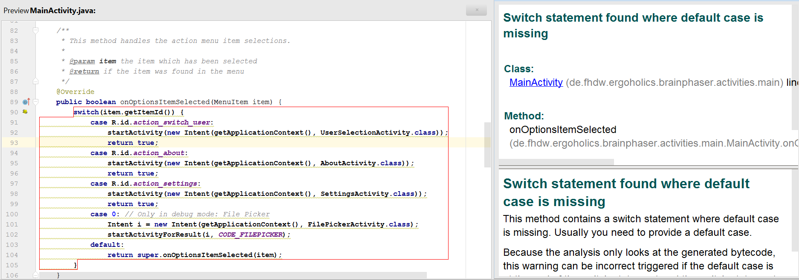

Slide 29
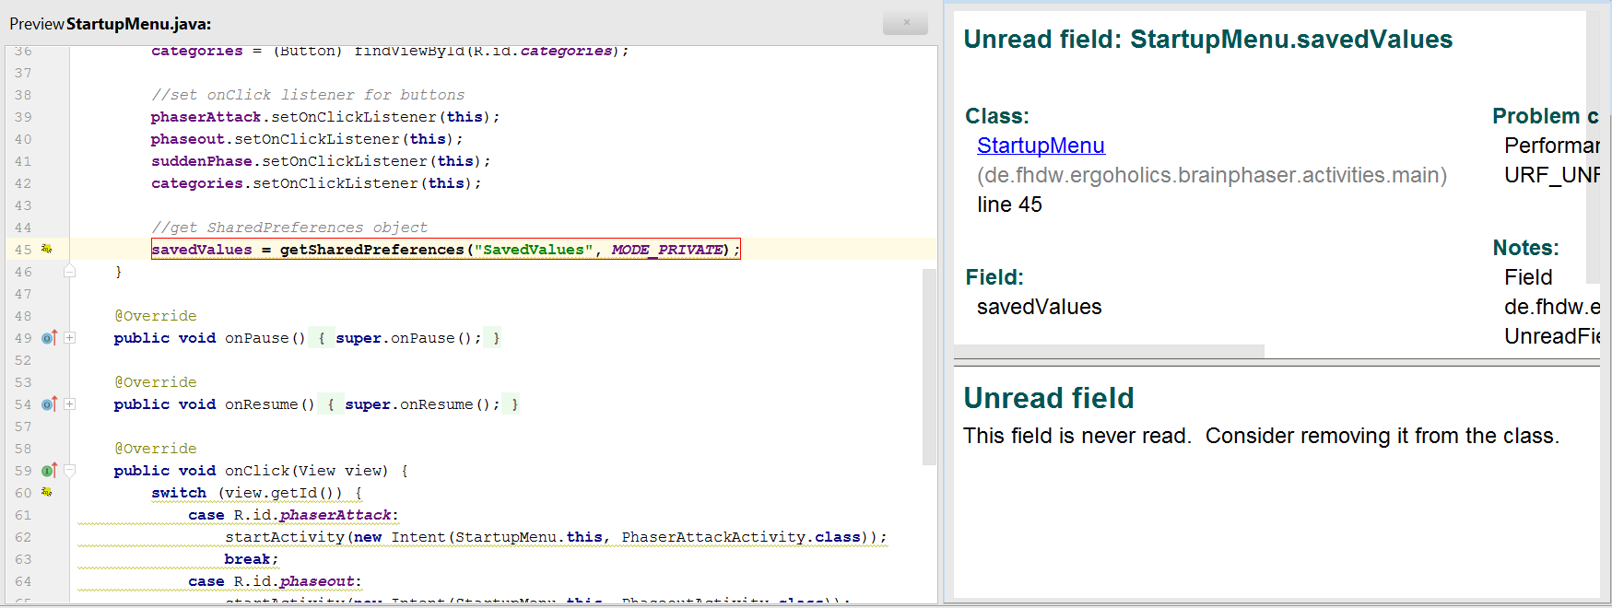

Slide 30
Road blocks?
//TODO TEAM

Slide 31
How did you overcome them
//TODO TEAM

Slide 32
QUESTIONS

